Slide 1

SMS Spam Filtering
Sejal Sharma (11021210009) Jagriti Sharma (11021210010)
This Photo by Unknown Author is licensed under CC BY-SA-NC

Slide 2
Agenda
Introduction
Problem Statement
Objective
Library Used
Dataset Used
Conclusion and Future Scope
Output
Presentation Title

Slide 3

Introduction
Short Message Service (SMS) is a very popular communication service, about 23 Million SMS were sent per minute.
Spam is unwanted message that is sent in bulk to a group of recipients. They are Intrusive and a waste of money, time and network bandwidth.
This Photo by Unknown Author is licensed under CC BY-SA-NC

Slide 4
Problem Statement
In today's digital age, mobile communication through SMS has become a key mode of communication. However, with the increase in SMS usage, there is a growing problem of unsolicited and harmful spam messages that can disrupt user experience and pose security threats. Spam messages often include promotional offers, phishing attempts, or other unwanted content that can waste users' time and may even lead to privacy breaches or financial loss. The aim of this project is to build a machine learning-based SMS Spam Filtering system using Python that can automatically classify incoming SMS messages as either 'Spam' or 'Ham' (non-spam).

Slide 5

Objective
Develop a robust machine learning model that can accurately classify SMS messages as either 'Spam' or 'Ham' using a labeled dataset.
Preprocess text data by removing noise, tokenizing, and applying feature extraction techniques like TF-IDF or word embeddings.
Compare the performance of various state-of-the-art classifiers, such as logistic regression, SVM, k-nearest neighbors, Bayes, decision trees, random forests, AdaBoost, and neural networks, to determine which one offers the best performance.
Achieve low misclassification rates for both spam and legitimate messages, aiming for less than 2% error rate using appropriate classifiers.

Slide 6
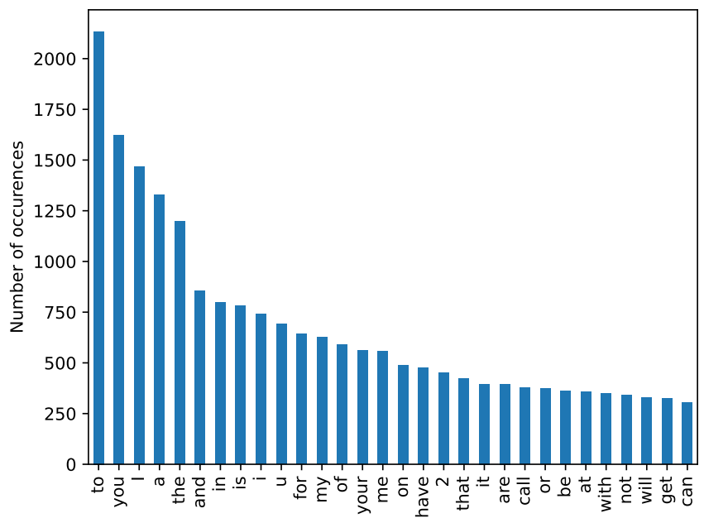
Dataset Used
The SMS Spam Collection Dataset consists of 5572 SMS messages, with 4825 labeled as legitimate (ham) and 747 as spam. It contains two columns: one for the label (spam or ham) and another for the message text.
Word Frequency

Slide 7
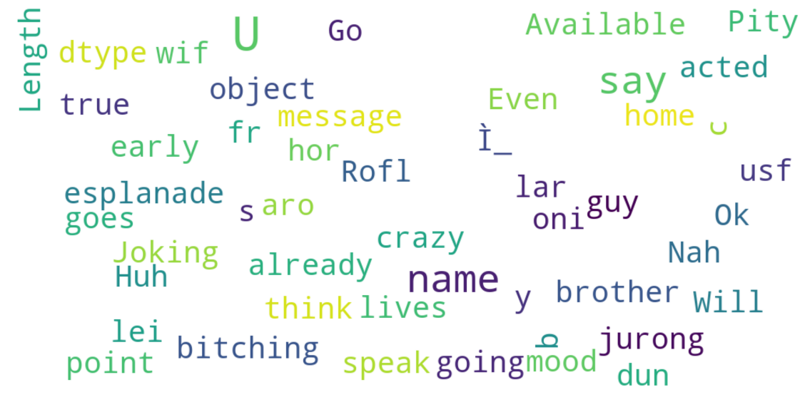
Wordcloud Ham (Not spam)

Slide 8
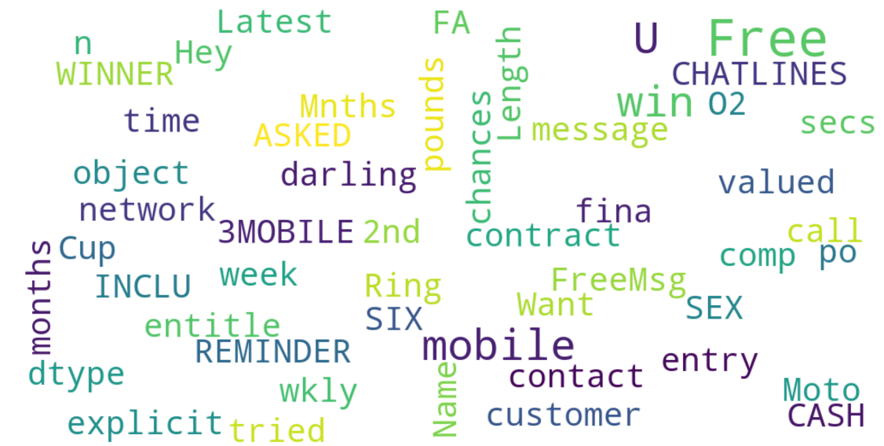
Wordcloud Spam

Slide 9
Libraries Used
pandas
sklearn
matplotlib
wordcloud
itertools
os
pickle
numpy
typing
logging
mpl_toolkits
collection

Slide 10
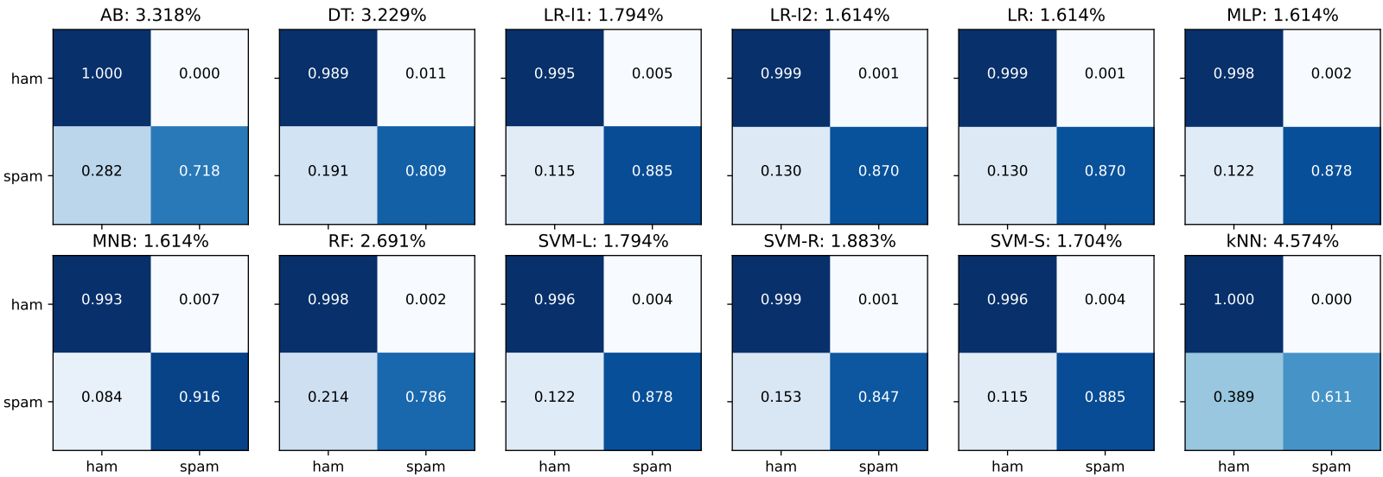
Output

Slide 11


Conclusion and Future Scope
Conclusion
Several SMS spam filtering methods have been studied from the feature extraction step to the classification step.
State-of-the-art classifier work well with misclassification error of less than 5%.
Online strategies have been adapted to deal with increasing vocabulary size.
Future Scope
Scaling (upscale / downscale) can be done to improve accuracy as the size of spam data in our dataset is less than ham data.
This system can be integrated with real time messaging platform or mobile SMS applications to filter messages instantly as they arrive.

Slide 12




Thank you

